Slide 1

Unicorn Companies

Slide 2
Agenda
Introduction
Analysis
Conclusion

Slide 3
The Definition of a Unicorn Company
A unicorn company is a private firm that has a valuation exceeding $1 billion, distinguished by innovation, disruption, and speedy growth.

Slide 4

The Importance of Analyzing Unicorn Companies for Investors
Investors who analyze unicorn companies gain valuable insights into high-growth opportunities, risk mitigation, and industry trends. This strategic toolkit is essential for making informed investment decisions in the ever-changing landscape of high-value private investments.

Slide 5
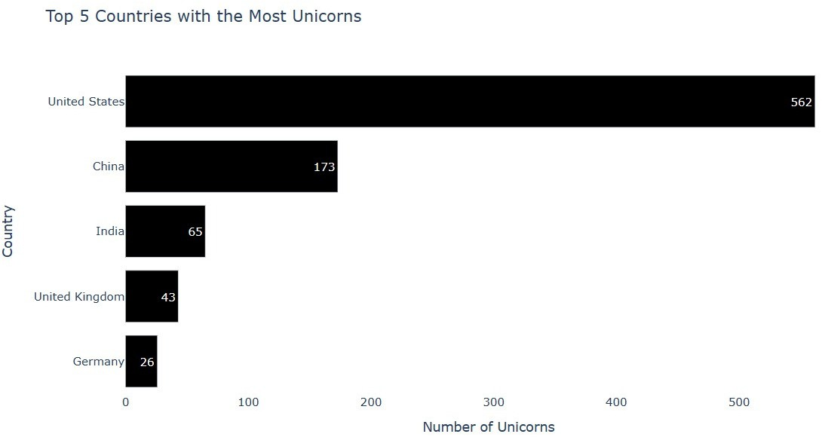

Slide 6
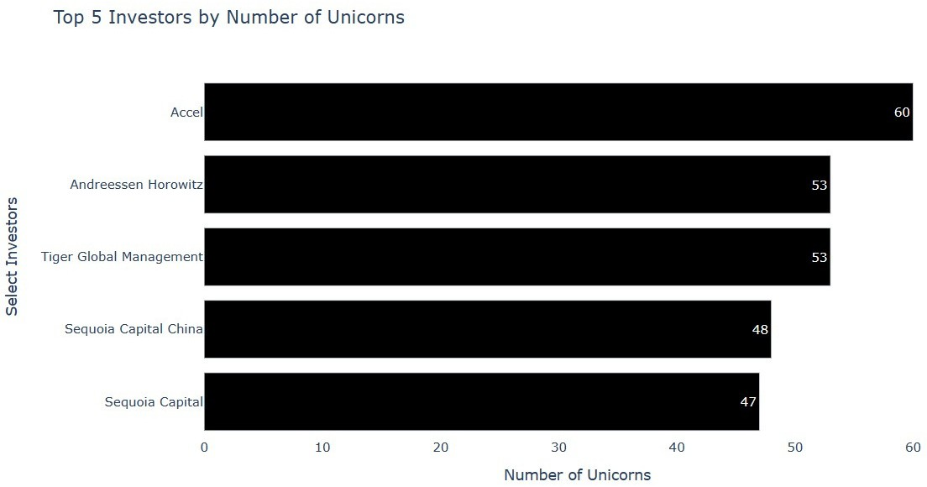

Slide 7
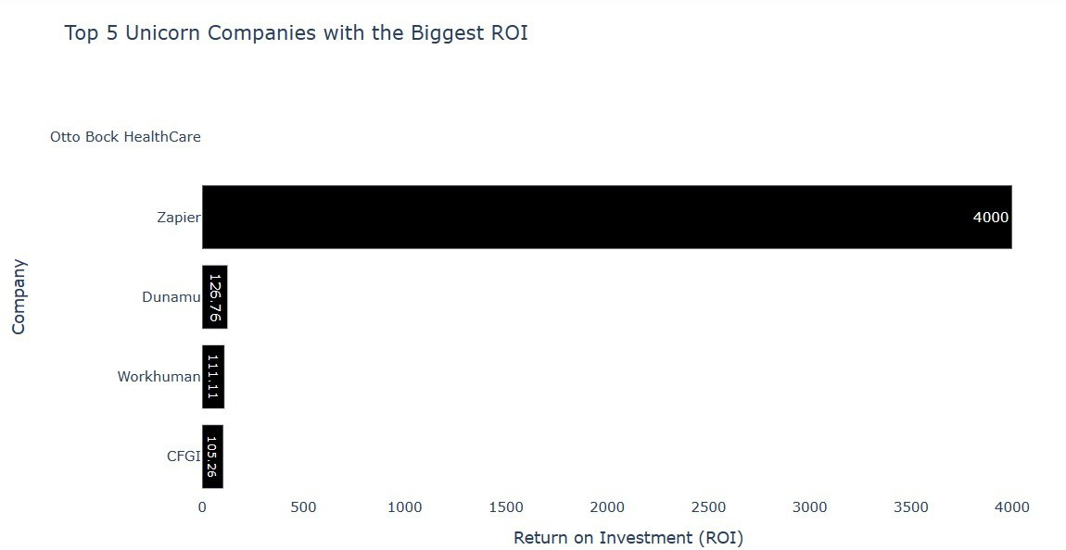

Slide 8
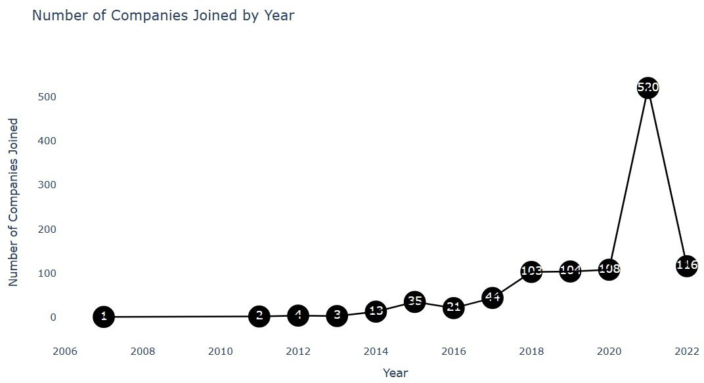

Slide 9
US Unicorn Dominance: The United States leads globally with the highest number of Unicorn Companies, showcasing its unparalleled position in fostering innovative startups.
Investment Powerhouse: Investors, notably Accel, play a pivotal role, fueling the growth of these unicorns and contributing to the country's thriving startup ecosystem.
Zapier's ROI Triumph: Zapier emerges as a standout with the most impressive Return on Investment (ROI), underscoring the potential for substantial returns in the tech sector.
Record-Breaking 2021: The year 2021 witnessed an extraordinary surge, with a staggering 520 companies attaining Unicorn status, highlighting the resilience and dynamism of the U.S. business landscape.

Slide 10
THANKS FOR WATCHING

